Slide 1
2025-2045 REGIONAL TRANSPORTATION PLAN
June 6
2024

Slide 2
What is a Regional Transportation Plan?
Regional Transportation Planning Agency requirement
“Required by law to ensure effective decision making relative to the implementation of the stated vision and goals”
Based on unique needs and characteristics of a region
RTP helps shape the region’s economy, environment and social future, and communicates regional vision to the state and federal government

Slide 3
What is a Regional Transportation Plan?
As fundamental building blocks of the State’s transportation system, the RTP should also support state goals for transportation, environmental quality, economic growth, and social equity (California Government Code Section 65041.1).
RTP must be prepared in accordance with adopted guidelines (2024)
RTP checklist – Must be completed to demonstrate compliance with state and federal requirements

Slide 4
State and Federal Policy and Funding Overview
California Transportation (CTP) 2040
“California is at a crossroads. California’s growing population and diverse economy are placing increased demands on the transportation system.”
“As California continues to grow and prosper, new trends and opportunities will emerge that require planning, innovation, and sustainable investments toward operating, managing, maintaining, and financing the State’s transportation system.”
“The CTP 2040 analyzes approaches for the State to achieve maximum feasible emission reductions in order to attain a statewide reduction of GHG emissions to 1990 levels by 2020, and 80 percent below 1990 levels by 2050.”
Recent policy changes to funding
requirements at both the State
and Federal Level

Slide 5
State and Federal Policy and Funding Overview
State Climate Change Goals
CAPTI builds on executive orders signed by Governor Gavin Newsom in 2019 and 2020 targeted reducing greenhouse gas (GHG) emissions in transportation, which account for more than 40 percent of all polluting emissions, to reach the state's ambitious climate goals.
Governor Newsom has established an aggressive goal for 100 percent of in-state sales of new passenger cars and trucks to be zero-emission by 2035.
CAPTI responds to the Governor’s call to action in EO N-19-19 by outlining strategies and actions that will advance more sustainable, equitable, and healthy modes of transportation, such as walking, biking, transit, and rail, as well as accelerate the transition to zero-emission vehicle technology.
Climate Action Plan for Transportation Infrastructure (CAPTI)

Slide 6
State and Federal Policy and Funding Overview
CSIS
CSIS Metrics:
Safety
VMT
Accessibility
DACs/Access to Jobs/Destinations
DAC traffic impacts
Passenger Mode Shift
Land Use and Natural Resources
Freight Sustainability and Efficiency
Caltrans System Investment Strategy - CSIS

Slide 7
California Policy Emphasis: Transportation Mode Shift Change Travel Behavior Decrease Vehicle Miles Traveled (VMT) Reduce GHG Emissions from Transportation Meet California Air Resources Board Regional Emission Reduction Targets Embrace Zero-Emission Vehicles and Infrastructure Encourage Technology Innovations

Slide 8
State and Federal Policy and Funding Overview
State transportation funds - including revenue collected under Senate Bill (SB) 1, the Road Repair and Accountability Act of 2017 - must be used solely on transportation.
As outlined in SB 1, California will continue the "fix-it-first" approach to maintaining the state's highways, roads and bridges.
Under CAPTI, where feasible and within existing funding program structures, the state will invest discretionary transportation funds in sustainable infrastructure projects that align with its climate, health and social equity goals.
Programs Include: Active Transportation Program (ATP),
Solutions for Congested Corridors (SCCP),
Local Partnership Program (LPP)
SB 1- Senate Bill 1

Slide 9
State and Federal Policy and Funding Overview
Federal
The Infrastructure Investment and Jobs Act (IIJA), aka Bipartisan Infrastructure Law (BIL), was signed into law by President Biden on November 15, 2021.
The law authorizes $1.2 trillion for transportation and infrastructure spending with $550 billion of that figure going toward "new" investments and programs.
$8 billion for the Infrastructure for Rebuilding America (INFRA) Program, which supports freight and highway projects of regional and national significance.
$7.5 billion for Rebuilding American Infrastructure with Sustainability and Equity (RAISE) grants
$5 billion for the National Infrastructure Project Assistance or “Megaprojects.” This program—sometimes referred to as the “Megaprojects program” or MEGA
IIJA – Infrastructure Investment and Jobs Act

Slide 10
PUBLIC TRANSIT
Emerging Transit Funding
SB 125
TIRCP, Transit and Intercity Rail Capital Program
ZETCP, Zero-Emission Transit Capital Program
Statewide Emphasis on Transit

Slide 11
Managed Lanes and Alternative Modes
MANAGED LANES
HOV Lanes
Transit Only Lanes
Tolled/Express Lanes
CARTA Capitol Area Region Toll Authority
ALTERNATIVE MODES
Bicycle/Pedestrian/Active Transportation
Transit
Work from Home
Carpooling
Managed Lanes, Transit and Alternative Modes as opposed to Roadway Capacity Expansion

Slide 12
Evacuation Resiliency Preparedness
Greater Placerville Wildfire Evacuation Preparedness, Community Safety, and Resiliency Study

Slide 13
Resiliency Evacuation Preparedness
US 50 Trip to Green Placerville

Slide 14
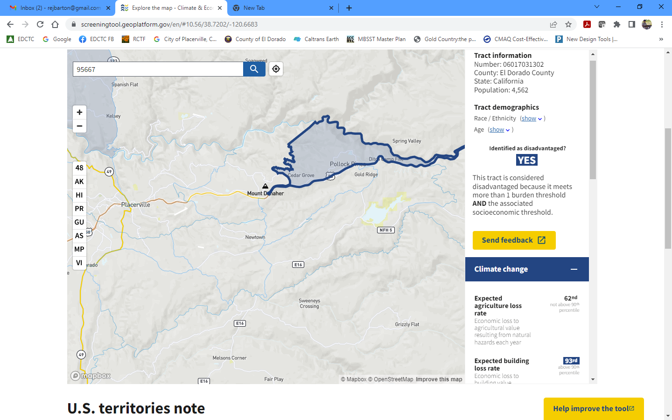
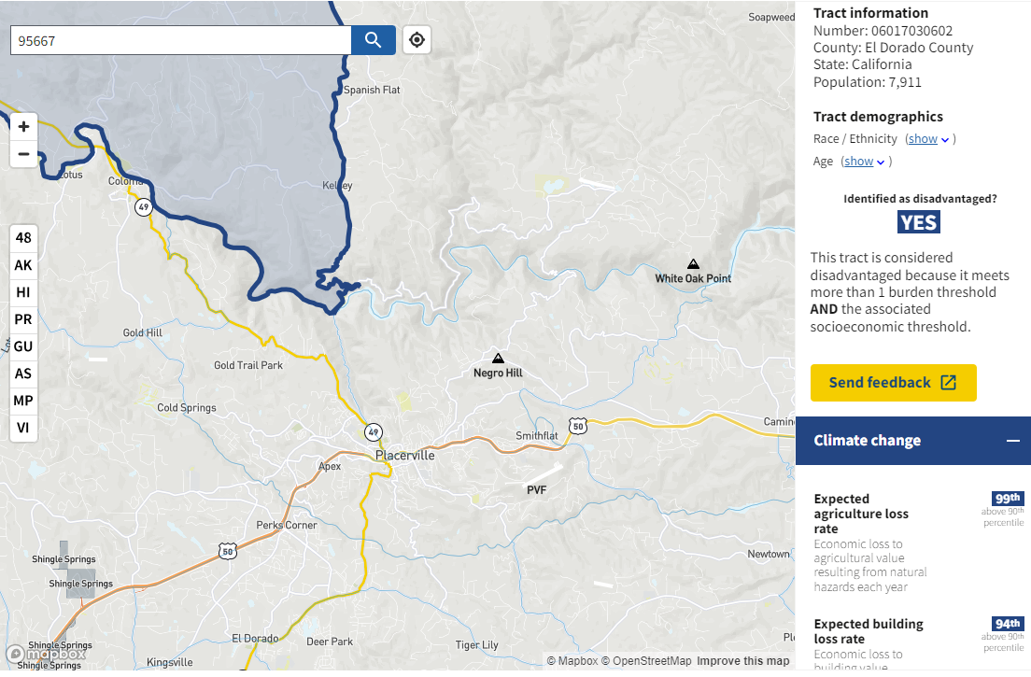
Equity/Environmental Justice/Justice 40
Next Generation Transportation Investments Strategy

Slide 15
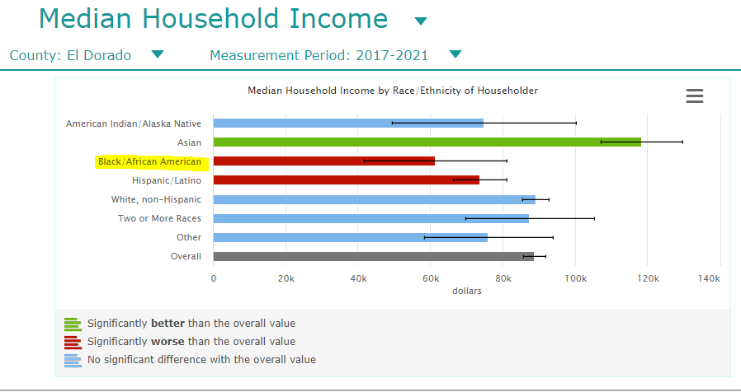
EL DORADO COUNTY SOCIOECONOMIC DATA
Median Income
Differences in median income by race/ethnicity faring significantly worse than the County overall).

Slide 16
DEMOGRAPHICS
Population Projections - SACOG
SACOG 2024 MTP/SCS Draft Growth Allocation
El Dorado County (excludes Tahoe Basin)

Slide 17
DEMOGRAPHICS
Dwelling Unit Projections -
SACOG 2024 MTP/SCS Draft Growth Allocation
El Dorado County (excludes Tahoe Basin)

Slide 18
DEMOGRAPHICS
Employment Projections - SACOG
SACOG 2024 MTP/SCS Draft Growth Allocation
El Dorado County (excludes Tahoe Basin)

Slide 19
EL DORADO COUNTY SOCIOECONOMIC DATA
Median Income
Differences in median income by geography also exist, with the lowest incomes concentrated in the areas of Placerville, Camino, Pollock Pines, 1 census tract in Cameron Park and certain census tracts in South Lake Tahoe.

Slide 20
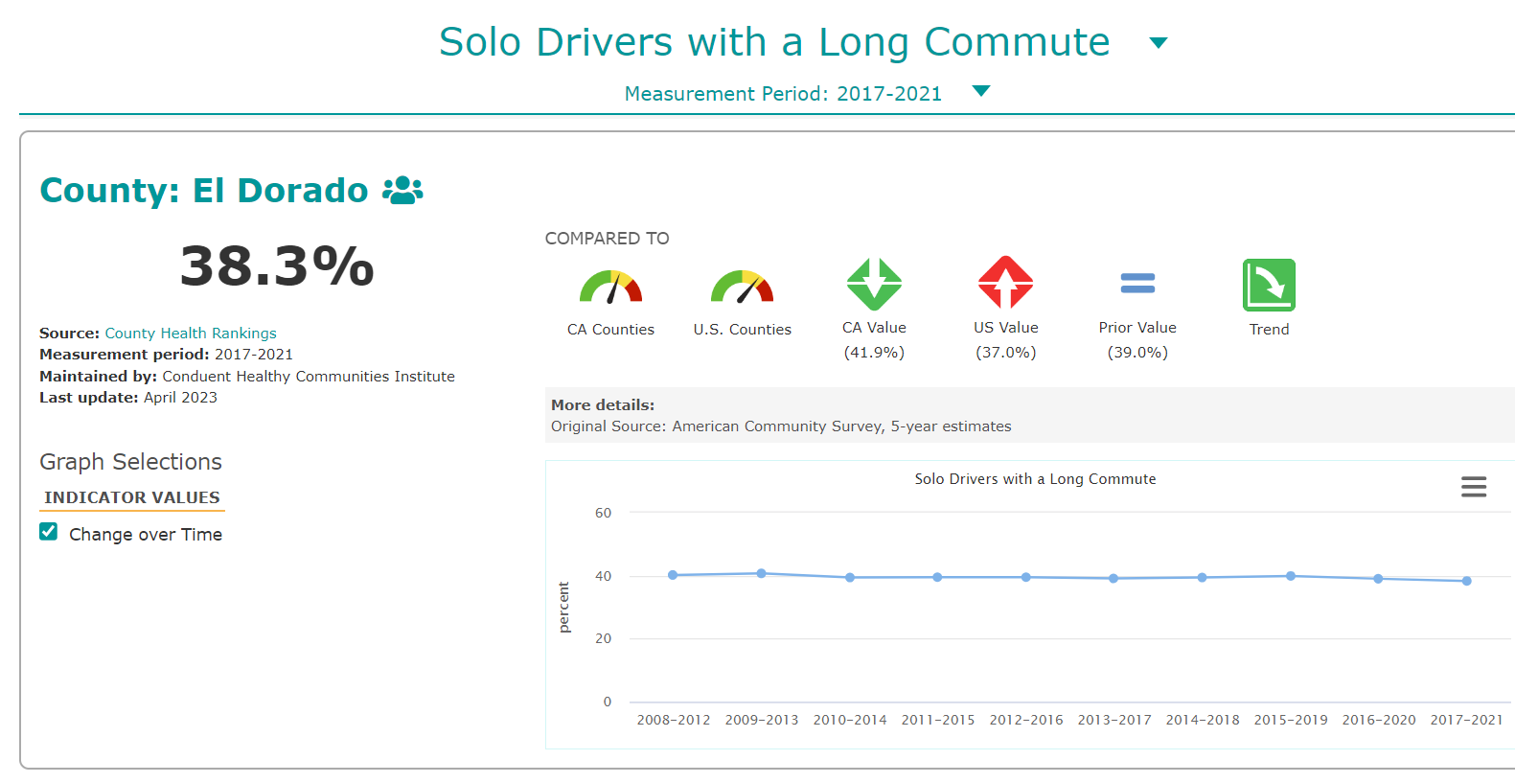
EL DORADO COUNTY COMMUTERS
EDC commute times are similar to other California counties; However, a large number of people drive alone to work and commute for more than 30 minutes, which differs from more urban regions.

Slide 21
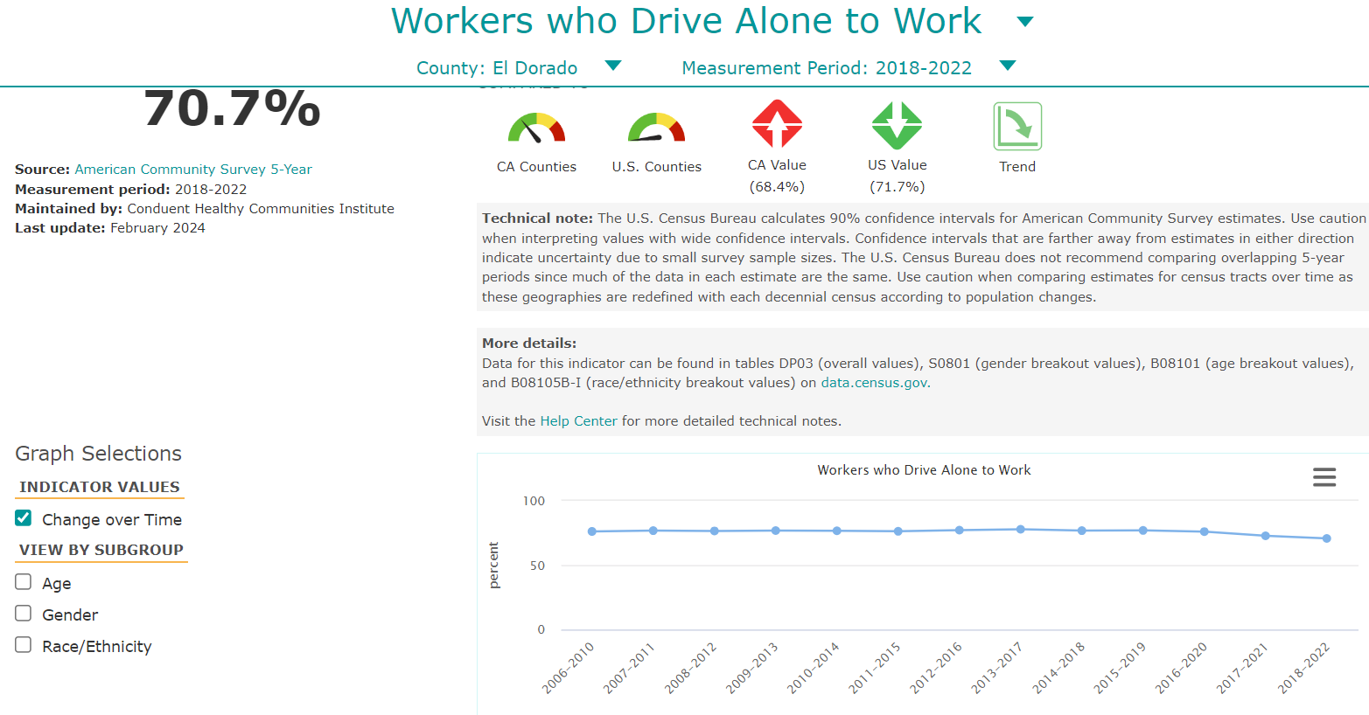
EL DORADO COUNTY COMMUTERS
EDC workers generally drive alone, however, the trend is declining slightly, likely due to home-based work situations, as opposed to increased alternative transportation modes

Slide 22
DRAFT RTP Vision Statement
Empowering Connectivity, Promoting Resiliency, Preserving Heritage:
EDCTC envisions a future of transportation which reflects and promotes the character of rural, suburban, and urban communities, prioritizes connectivity, adapts to a changing climate, is resilient, and serves the needs of all who rely on the transportation system throughout El Dorado County.

Slide 23
DRAFT RTP Vision Statement
Empowering Connectivity, Promoting Resiliency, Preserving Heritage:
Enhances Mobility: Our plan aims to provide efficient and accessible transportation options, connecting rural regions, agritourism, and communities, fostering economic growth, and safe and sustainable communities.
Embraces Innovation: We anticipate a future where innovative technologies are harnessed to enhance transportation efficiency, safety, and the overall quality of life for residents and visitors alike.
Ensures Equitable Access: Our vision includes a commitment to providing transportation options that are accessible to all, bridging gaps and ensuring that every resident and visitor alike can fully participate in the opportunities El Dorado County has to offer.

Slide 24
DRAFT RTP Vision Statement
Empowering Connectivity, Promoting Resiliency, Preserving Heritage:
Celebrate Rural Heritage and Identity: We envision a transportation system that celebrates the distinct identity of our rural communities, preserving their heritage, understanding their issues, and promoting opportunities.
Empowers Community Engagement: Through active community involvement, our plan seeks to empower residents to actively shape the transportation future of rural El Dorado County, fostering a sense of ownership and pride.
Facilitates Sustainable Living: We aspire to create a region where sustainable transportation options are not just preferred but celebrated, reducing our environmental impact and promoting a healthier way of life.

Slide 25
GOAL 1: Integrated Regional Transportation Planning
Integrate land use, air quality, and public engagement into regional transportation planning and project delivery to better serve the users, enhance the economy, and preserve the environment and community character.

Slide 26
GOAL 2: Sustainable, Adaptable, Resilient
Implement regional transportation investments which provide context sensitive options, embrace emerging technologies, and greatly improve accessibility, mobility, and climate emergency preparedness.

Slide 27
GOAL 3: Surface Transportation System
Optimize the existing highways, streets, and roads to enhance maintenance and operations, maximize capacity, and improve safety.

Slide 28
GOAL 4: Public Transit
Promote a convenient, desirable, and reliable public transit system which is accessible to and provides effective transport across the diverse geography of the region.

Slide 29
GOAL 5: Aviation
Promote and preserve aviation facilities and services that complement the regional transportation system and support critical emergency response.

Slide 30
GOAL 6: Active Transportation
Complete a safe, convenient, and connected active transportation system for all users.

Slide 31
GOAL 7: Transportation Systems Management
Develop and support an integrated transportation system that incorporates corridor management solutions and public awareness of mobility options to limit vehicle miles travelled and maximize capacity.

Slide 32
GOAL 8: Regional Equity and Collaboration
Engage in inclusive regional transportation planning advancing equity through meaningful transportation investments to empower the historically underserved

Slide 33
NEXT STEPS
Start work on Action Element, discuss project lists, by mode
Hold 2-3 more RTPAC meetings, plus additional traditional and non-traditional outreach events
Start work on EIR
Start work on Financial Element

